Slide 1


Hotel Aggregator Analysis with Power BI
By Aman Srivastava
Data Analyst Intern at Mentorness
Batch – MIP-DA-07

Slide 2
CONTENTS
Introduction
Objective
Dashboard

Slide 3
introduction
This internship project aims to analyse a dataset of hotel aggregator listings using Power BI. The dataset
comprises various attributes related to listings, hosts, reviews, and availability. The objective is to create
comprehensive visualizations and insights that shed light on trends, patterns, and factors influencing the
performance of listings. Through Power BI, interns will explore key metrics such as pricing, availability,
host characteristics, and review scores to derive actionable insights for improving the overall quality and
competitiveness of the listings.

Slide 4
Objectives:-
Visualize the distribution of listings on a map to identify popular neighborhoods.
- Analyze pricing trends based on property types, room types, and accommodation capacity.
- Investigate the availability of listings over time and identify peak periods.
- Evaluate host characteristics, including superhost status, response times, and verification methods.
- Analyse the distribution of property types and room types.
- Explore trends in the popularity of specific accommodation setups.

Slide 5
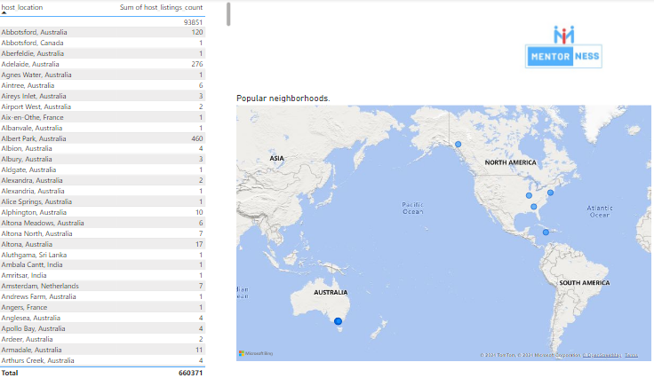
Dashboards:-

Slide 6
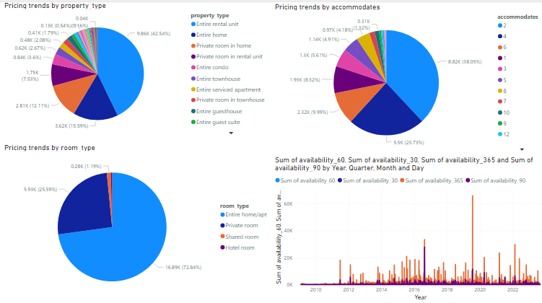

Slide 7
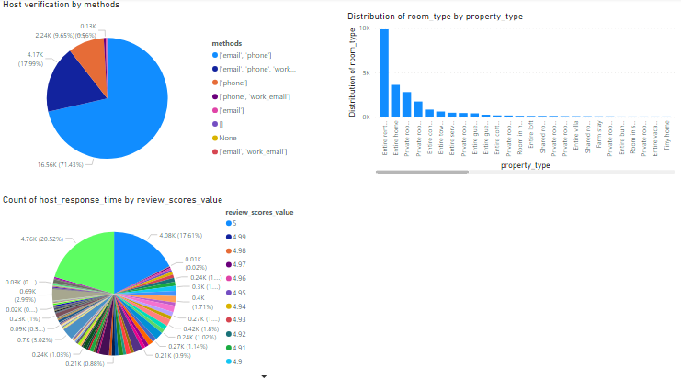

Slide 8


